Slide 1
Introduction to image Analysis
Segmentation 1
Robert Haase, HongKee Moon, Benoit Lombardot
MPI-CBG, Scientific Computing Facility
October 23rd - 25th 2017
Section goals :
Introduce the concept of thresholding, mask and regions
Using Image threshold, particle analyzer and maxima finder
Get Started with Image and Mask Filters

Slide 2
Overview
Image Analysis, Segmentation 1
Day 1:
Introduction & basic concepts
Segmentation 1
Day 2:
Measure in time sequence and tracking
Segmentation 2
Day 3:
Visualize and Explore 3D images
Spot detection and segmentation in 3D

Slide 3

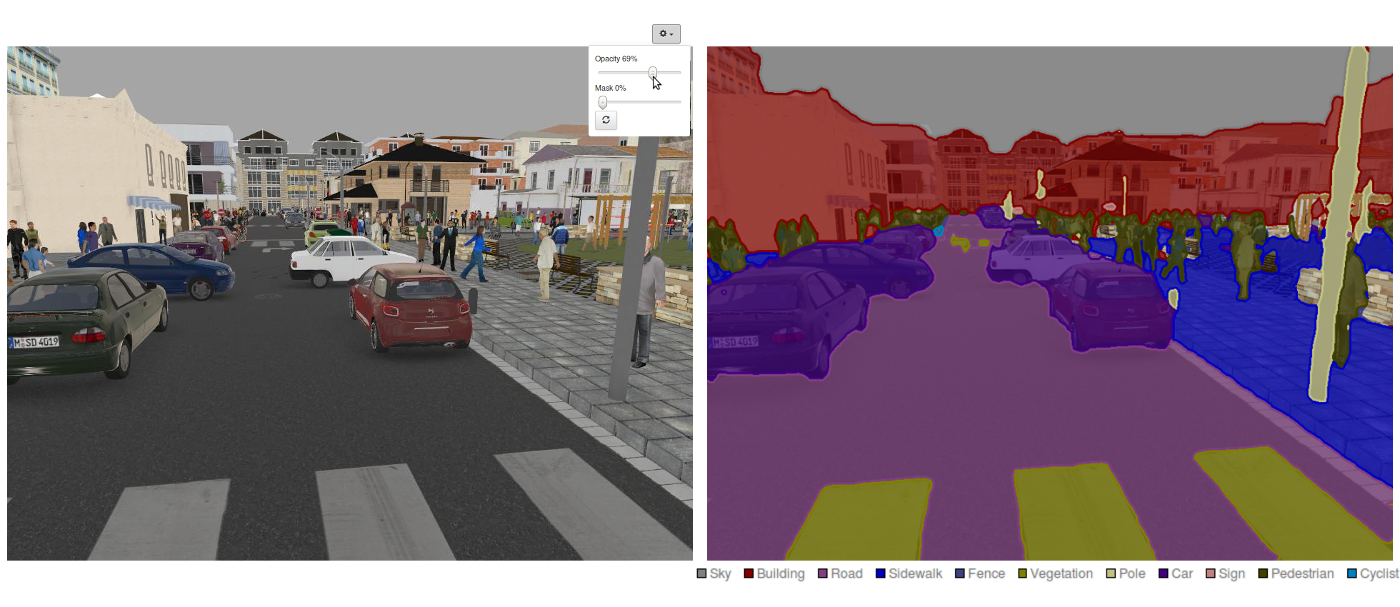
Image Analysis, Segmentation 1 Segmentation
➔Its goal is to partition image in meaningful regions
Notes:
Creating roi is fundamental to analysis but can be tedious
Automate roi tracing
Faster, Objective, Repeatable
As for manual Rois we would like to detect points, lines and regions
There isn’t one tool for that but many that need to be used together
By the end of the day will be able to count nuclei, measure their area and size, the # of transcripts per nuclei.

Slide 4

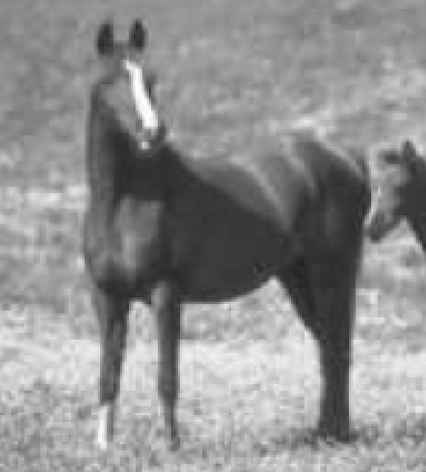

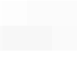
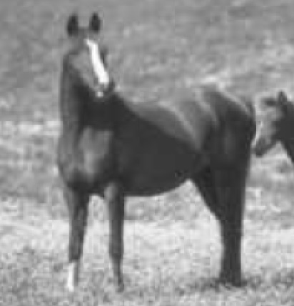







Image Analysis, Segmentation 1 Representation
A proxy to do measures
e.g. horse height?
?
Notes:
Quantify:
For us, simplified proxy to describe how it is done and in turn repeat it if necessary
The measure definition can be automated on a computer
Explicit measure definition
Repeatible, Sharable

Slide 5
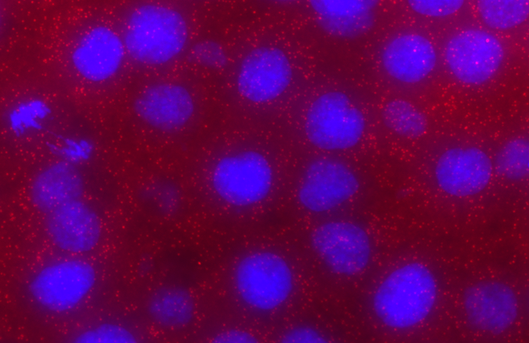
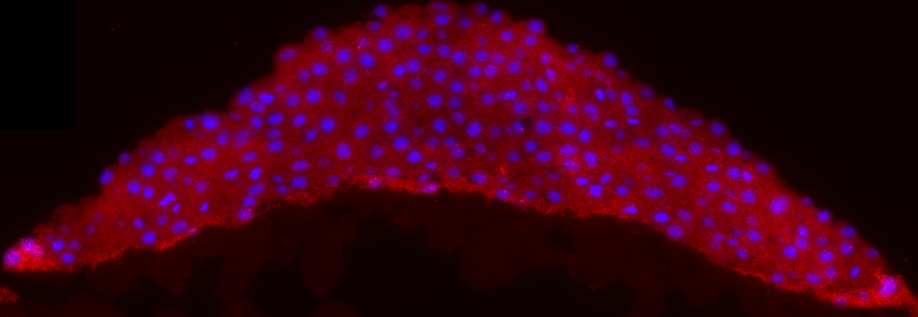
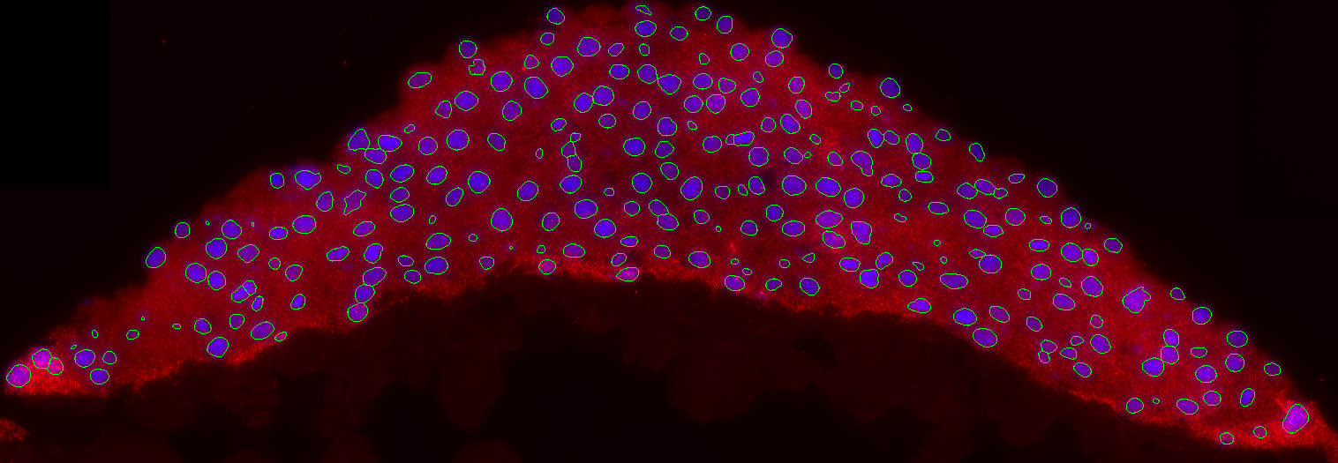
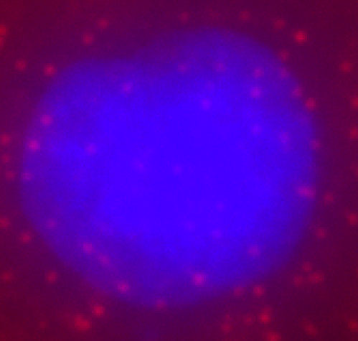
Image Analysis, Segmentation 1 Motivations
Image source: Carine Stapel (Vastenhouw lab, MPI-CBG)
Objectivity
Reproducibility
Throughput
Notes:
Creating roi is fundamental to analysis but can be tedious
Automate roi tracing
Faster, Objective, Repeatable
As for manual Rois we would like to detect points, lines and regions
There isn’t one tool for that but many that need to be used together
By the end of the day will be able to count nuclei, measure their area and size, the # of transcripts per nuclei.

Slide 6
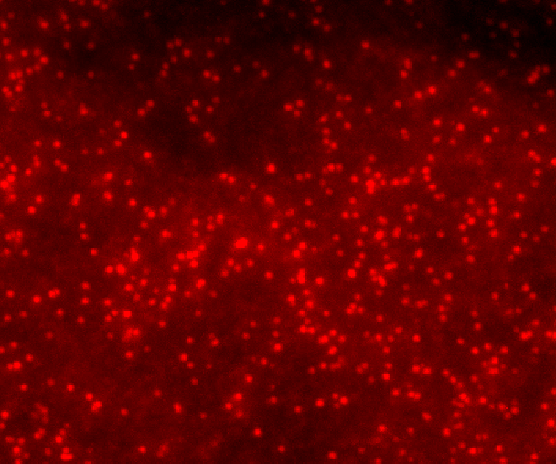
Counting Objects
Notes:
Object can’t be separated with a threshold
One only need to count objects or know there position, intensity

Slide 7
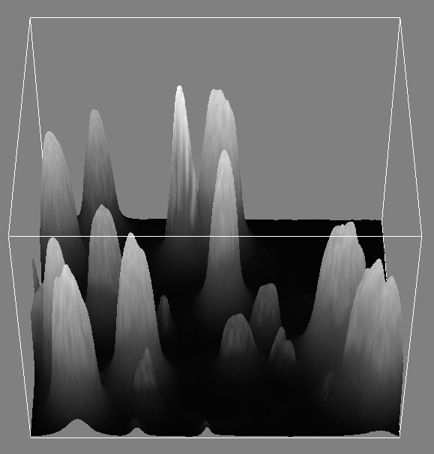
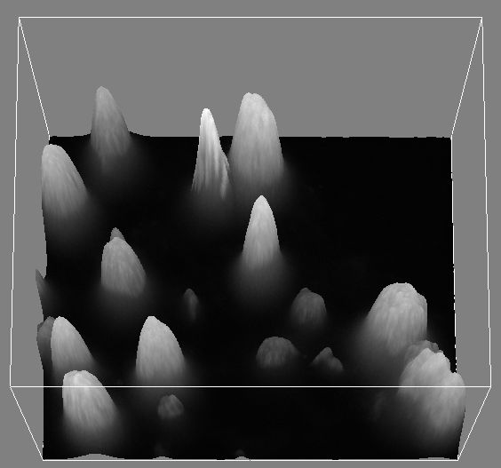
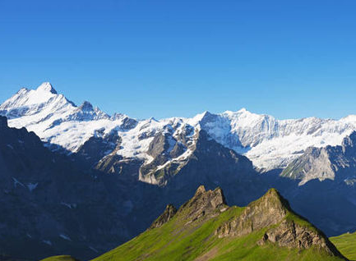
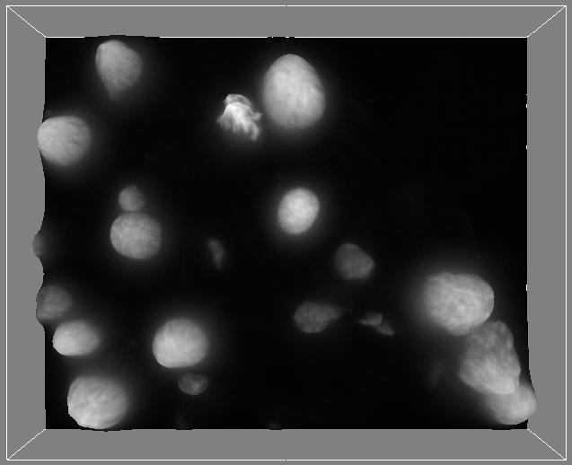
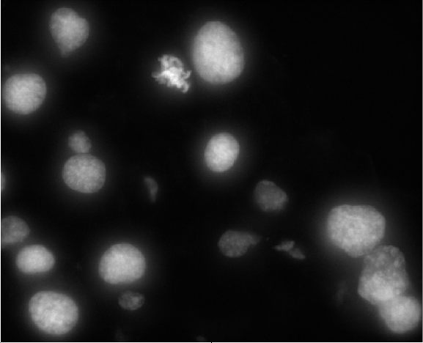
A useful metaphor
Image Analysis, Segmentation 1
Image is a landscape of hills and valleys
Notes:
Rk: Threshold is not the only way to create a mask. We’ll see other example on day 2 (but for now no need to bring confusion)

Slide 8
Maxima of intensity
Image Analysis, Segmentation 1
➔ As many object as maxima of intensity
Notes:
Rk: Threshold is not the only way to create a mask. We’ll see other example on day 2 (but for now no need to bring confusion)

Slide 9
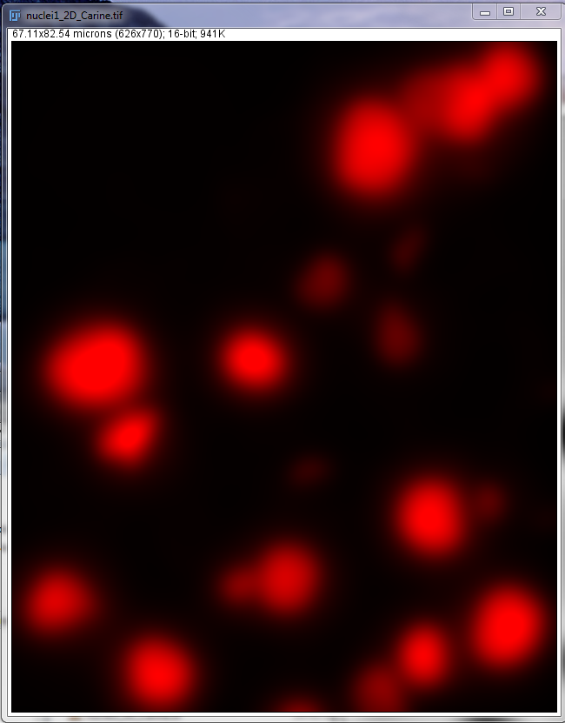
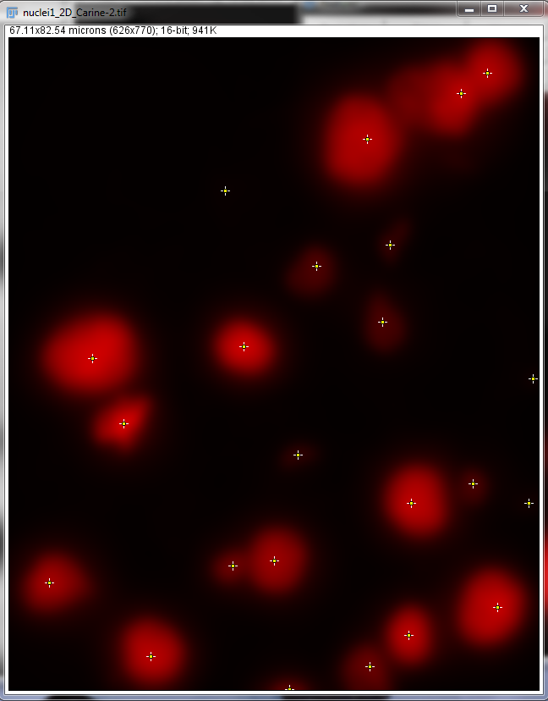
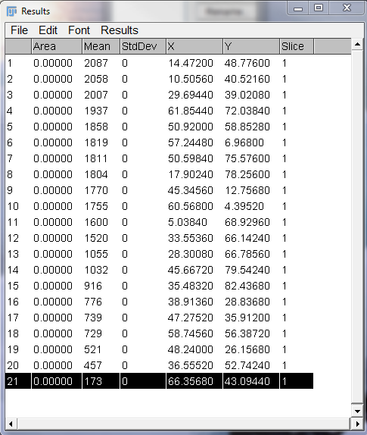
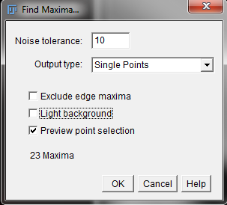
Image Analysis, Segmentation 1 Count object in Fiji
Menu process>find maxima …
Notes:
If we remove the noise and cell texture from the image, only the large scale structure will remain and our hypothesis of one maxima per object has more chance to true
The gaussian filter can be used to remove the small scale details of the image.
1. Try it and apply the find maxima filter. A gaussian filter of radius 7 pixel gives good results for further detection.
Note how the result is more robust to change in the noise parameter than earlier.
There are almost no over-detection in the objects. A few maxima are also detected in the background. one can get rid of them based on their intensity.
2. Increase the tolerance till getting rid of the false detection (it might not be perfect but noise=50 gives me good result ;-)
3. Set the output to “Point selection” and click ok.
4. Measure (press Ctrl+M key or menu Analyze measure), note that if the false detection are in the background it is possible to detect them thanks to their low intensity
Rk: Normally in a completely automated strategy as much parameter as possible should be chosen automatically.
Rk2: False detection in the background could be detected automatically Next slide propose an approach for that
When does it worth setting up this automated detection?
Not to count 20 cell, it would be faster manually.
If object are quite packed the threshold
But it you have images with hundreds or thousand of cells it worth.
If the process is too long it is possible to prepare a macro to make all the processing in one click

Slide 10
Region
Segmentation
Notes:
Rk: Threshold is not the only way to create a mask. We’ll see other example on day 2 (but for now no need to bring confusion)

Slide 11
Thresholding
Image Analysis, Segmentation 1
Thresholding consist in selecting region above a given altitude
Notes:
Rk: Threshold is not the only way to create a mask. We’ll see other example on day 2 (but for now no need to bring confusion)

Slide 12
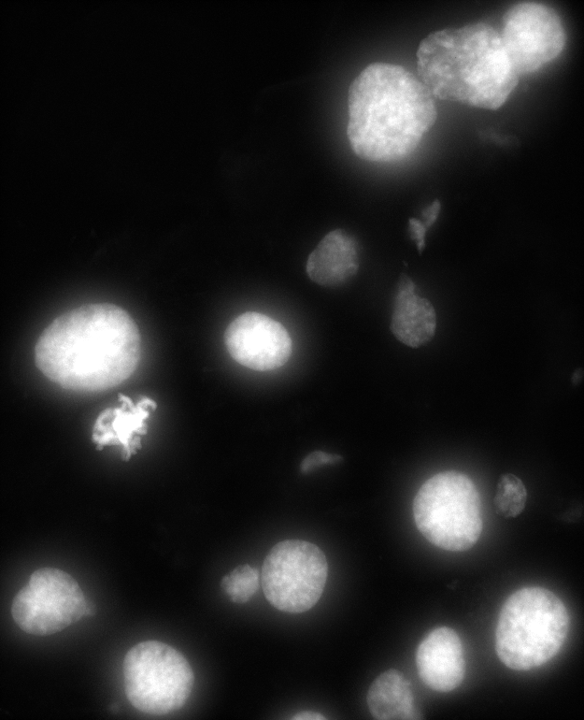
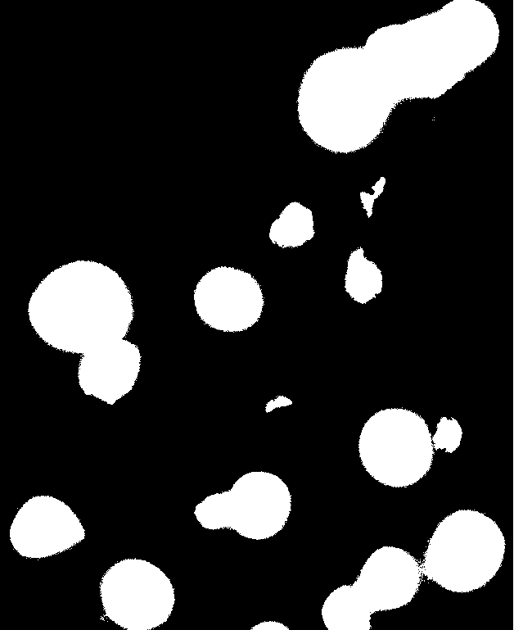
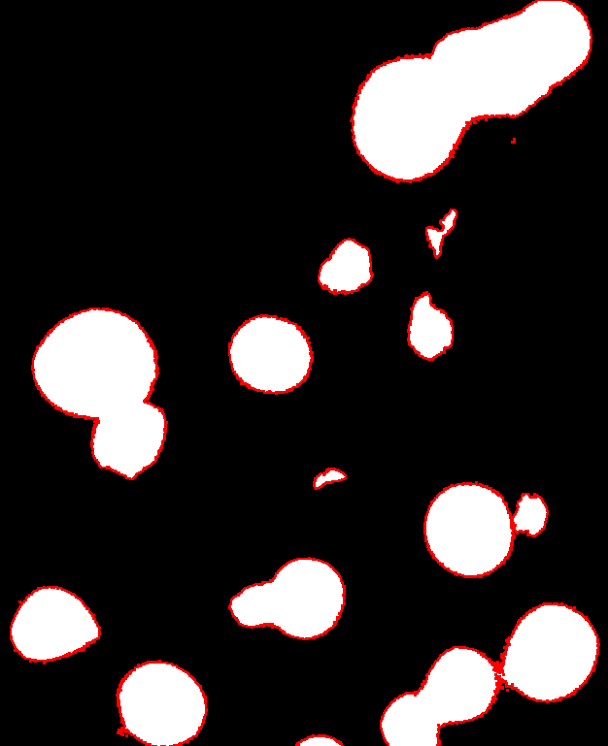
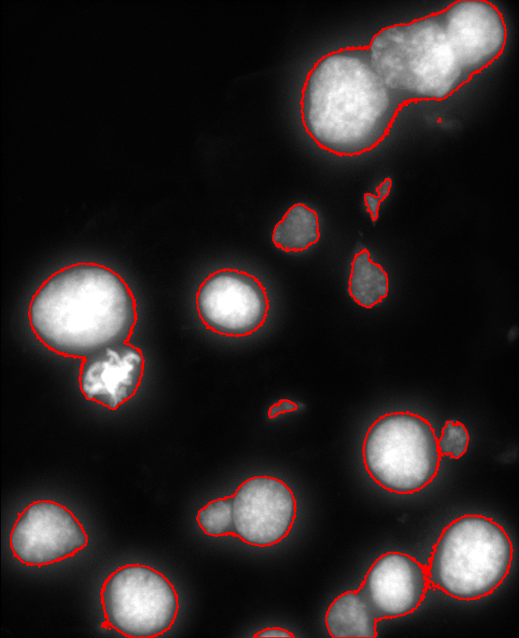
Thresholding
Image Analysis, Segmentation 1
Principle: All pixel above a threshold of signal are set to a value while the others are set to 0
Thresholding
Threshold=500
Notes:
Rk: Threshold is not the only way to create a mask. We’ll see other example on day 2 (but for now no need to bring confusion)

Slide 13
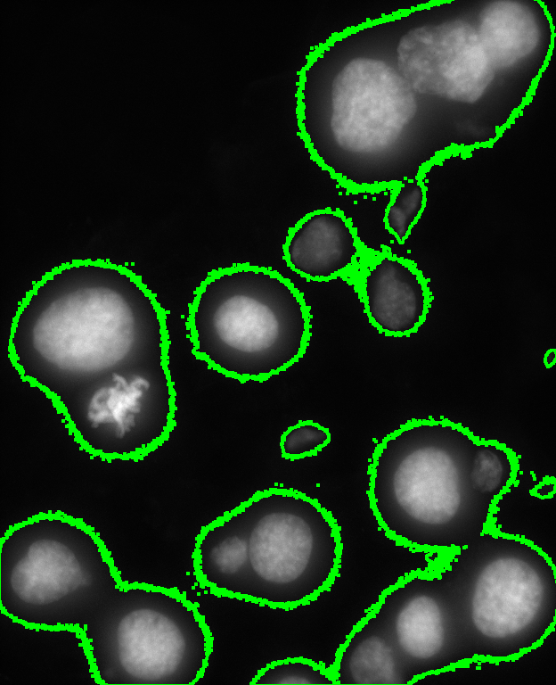
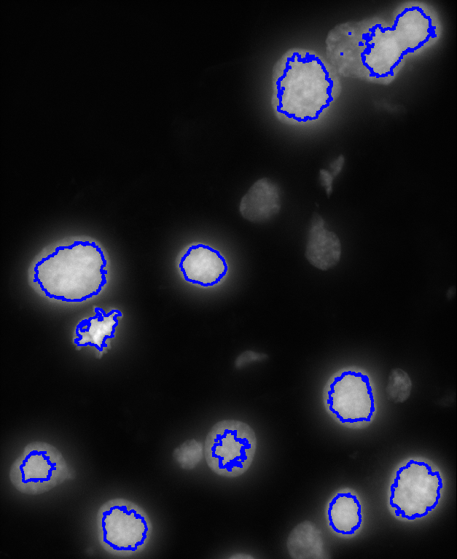
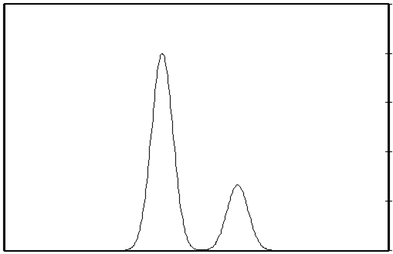
Thresholding
Image Analysis, Segmentation 1
Image intensity distribution
Number of pixels
Background
Objects
Intensity
Many technics to determine T
e.g. Otsu: minimize the intra class variance

Slide 14
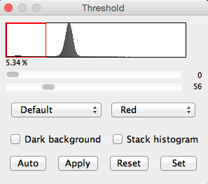
Thresholding in Fiji
Image Analysis, Segmentation 1
Menu Image > Adjust > Threshold
Sliders select min and max of selected pixels
Apply creates a mask
Switching Dark background inverts the selection
Notes:
Selection is shown in Red in histogram and the image

Slide 15

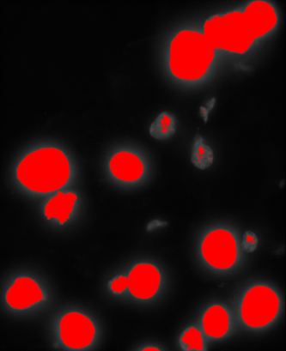
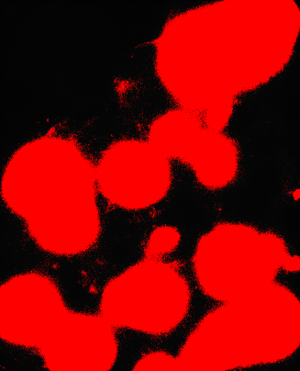
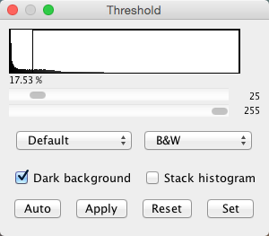
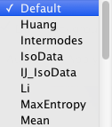
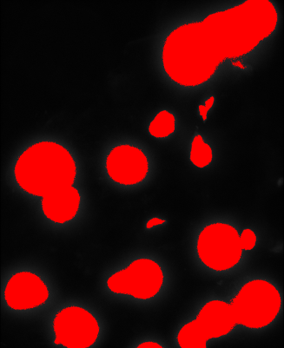
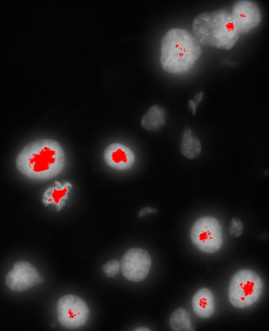
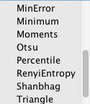
Thresholding tool
Image Analysis, Segmentation 1
HOW TO do this in FIJI
Automatic thresholding methods
→ Citable
→ Objective/repeatable measures
Menu Image > Adjust > Threshold …

Slide 16
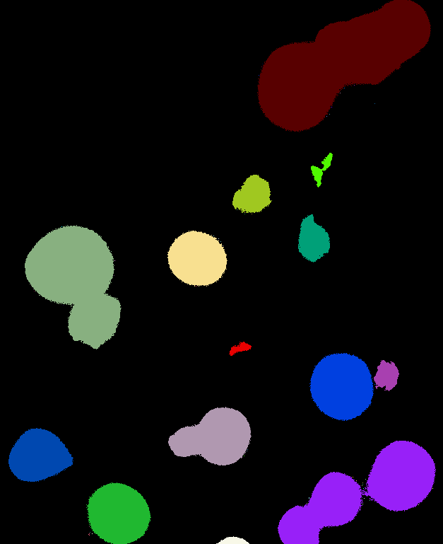
Connected Component labeling (CCL)
Image Analysis, Segmentation 1
How many regions?
1!
➔Computer does not know regions
➔Unless it is provided with label
14
Notes:
Mask is one region to one measure

Slide 17

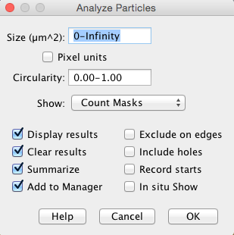
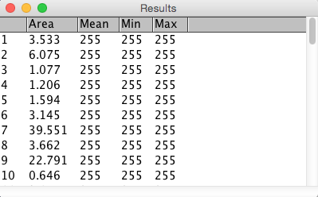
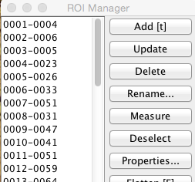
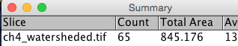
The Particle analyzer
Image Analysis, Segmentation 1
?
HOW TO do this in FIJI
Menu Analyze > Analyze particles

Slide 18
Hands on
Notes:
Up to 1 hour:
Maxima detection with spot_detection.tiff
Show how to use maxima finder
Show how to choose the noise parameter
Show the different type of output
Threshold with blobs.tiff
relation object background
Selection of the method
Show the image value when threshold is applied
Show how to create selection from mask
Region analysis:
Only (8 bit) thresholded images
Remove small region
Link to roi manager
Link to measure
Segmentation workflow,
introduce use case where standard threshold does not work alone
Image preparation: nile bend.jpeg (easier to threshold a graylevel image)
Blurring: find a noisy image (nile bend can do)
Subtract background cell2D_bg.tiff
Fill holes
Watershed (example that works and doesn’t)

Slide 19
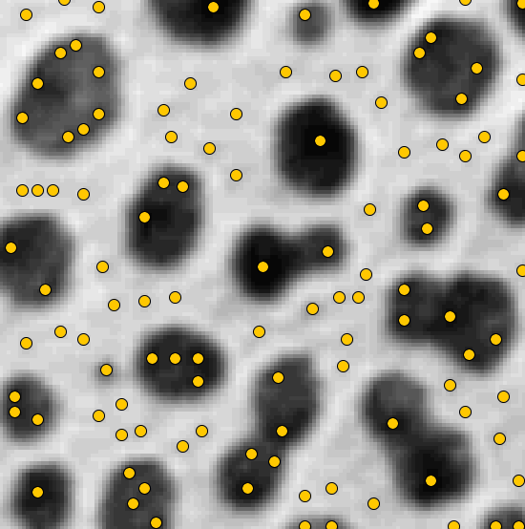
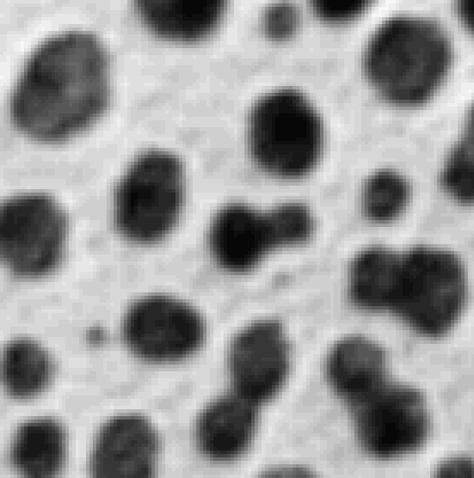
H-Maxima
Image Analysis, Segmentation 1
Can one detect Object With Maxima?
→Maxima are sensitive to noise
Notes:
Watershed works if maxima match with object we search

Slide 20
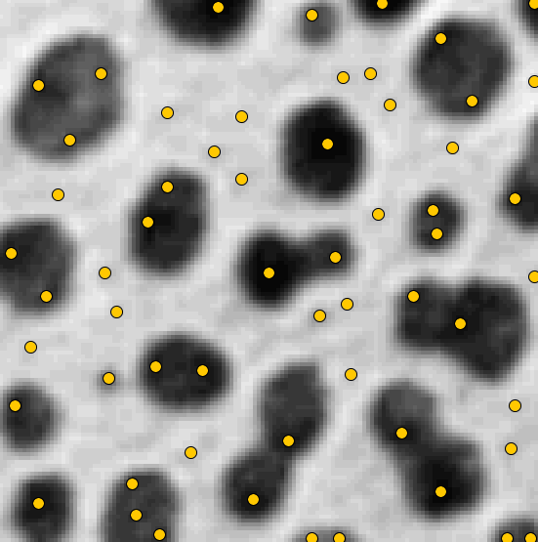
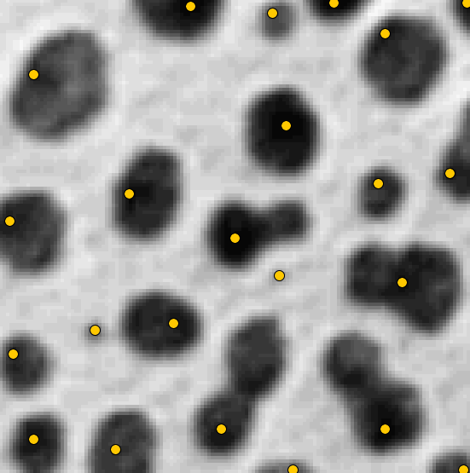
H-Maxima
Image Analysis, Segmentation 1
Can one detect Object With Maxima?
→Maxima are sensitive to noise
Some maxima are more robust to noise
→ Select maxima by their dynamics
H-Maxima, H=10
H-Maxima, H=0
H-Maxima, H=40
Notes:
Watershed works if maxima match with object we search

Slide 21
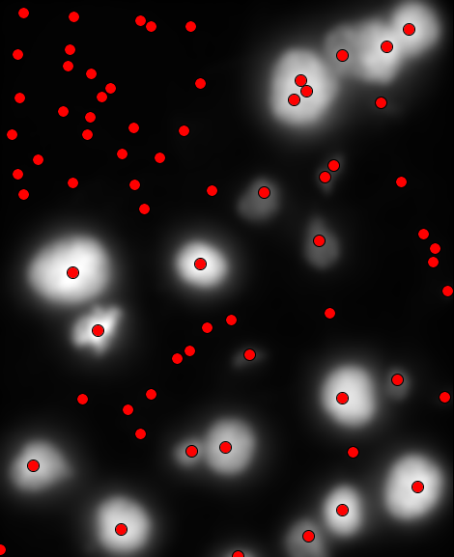
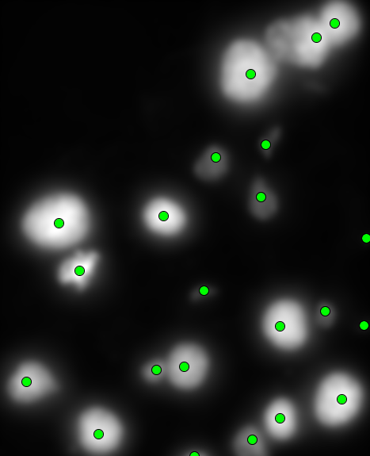
Image Analysis, Segmentation 1 Spot detection
Choose noise as a fraction of peak height
Noise = 0
Noise = 50
Peak height is the signal difference between the peak and the background nearby. If 2 objects are close use the intensity in between them.
Notes:
If we remove the noise and cell texture from the image, only the large scale structure will remain and our hypothesis of one maxima per object has more chance to true
The gaussian filter can be used to remove the small scale details of the image.
1. Try it and apply the find maxima filter. A gaussian filter of radius 7 pixel gives good results for further detection.
Note how the result is more robust to change in the noise parameter than earlier.
There are almost no over-detection in the objects. A few maxima are also detected in the background. one can get rid of them based on their intensity.
2. Increase the tolerance till getting rid of the false detection (it might not be perfect but noise=50 gives me good result ;-)
3. Set the output to “Point selection” and click ok.
4. Measure (press Ctrl+M key or menu Analyze measure), note that if the false detection are in the background it is possible to detect them thanks to their low intensity
Rk: Normally in a completely automated strategy as much parameter as possible should be chosen automatically.
Rk2: False detection in the background could be detected automatically Next slide propose an approach for that
When does it worth setting up this automated detection?
Not to count 20 cell, it would be faster manually.
If object are quite packed the threshold
But it you have images with hundreds or thousand of cells it worth.
If the process is too long it is possible to prepare a macro to make all the processing in one click

Slide 22
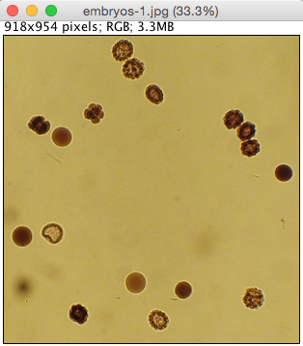
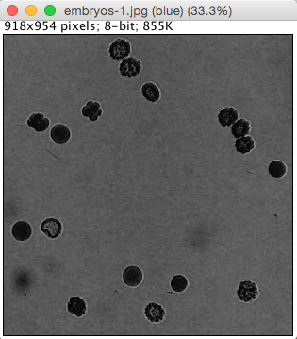
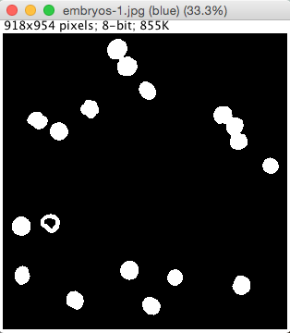
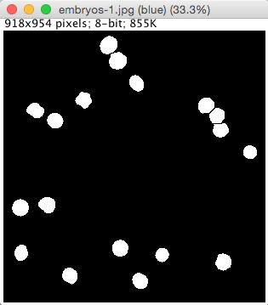
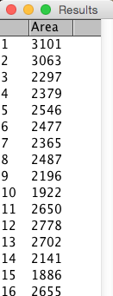
Typical pipeline
Image Analysis, Segmentation 1
Pre-processing
Segmentation / Regionalisation
Post-processing / correction
Measurement
Change imaging technique / parameters
Notes:
It is the same pipeline as before but we try to automate the object manual selection
Interest?
Quicker (can be discussed)
More repeatable
More Objective
The section will show how to measure automatically the size of all embryo

Slide 23
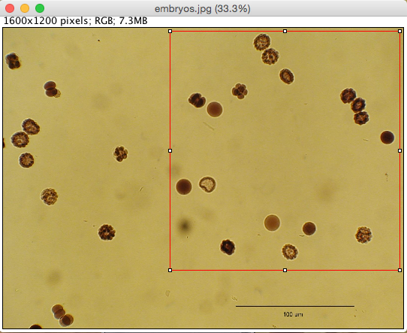



Prepare thresholding
Image Analysis, Segmentation 1
Select a region to analyze
Adapt the type of the image
For instance apply Image > Type > 8-bits
Or Image > Color > Split Channels
Split channels
Notes:
Duplicate original image before processing to avoid loosing it

Slide 24


Spatial Filters
Image Analysis, Segmentation 1
A filter transform an image into an other image of same dimension
Filter
Image source: Martin Anger (Dubrovska lab, Oncoray)
Notes:
Filter have specific effect on the image that are used to get rid of unwanted characteristics or enhance others

Slide 25



Spatial Filters
Image Analysis, Segmentation 1
Many filter updates each pixel as a function of its neighborhood intensities
Below, the pixel (i,j) and a rectangular neighborhood of dimension 3x3
Filter
1
1
1
i,j
=
i,j
*
1
1
1
i,j
1
1
1
Notes:
Not all filter can be explained this way but many can (erosion, dilation, convolution, basic local maxima, )

Slide 26
Spatial Filters
Image Analysis, Segmentation 1
HOW TO do this in FIJI
Menu
Process > Binary > …
Process > Math > …
Process > Filters > …
The filter is characterized by:
The Neighborhood shape
3x3
5x5
1x5, 45 degree
The function applied to the neighborhood
1
0
-1
minimum( )
i,j
*
2
0
-2
i,j
1
0
-1
Vertical edge filter
Erosion filter
Notes:
Filter have specific effect on the image that are used to get rid of unwanted characteristics or enhance good characteristics

Slide 27



Denoising: Gaussian blur
Image Analysis, Segmentation 1
HOW TO do this in FIJI
Menu Process > Filters > Gaussian blur…
Image: Carine Stapel, Vastenhouw lab, MPI_CBG

Slide 28



Denoising: Gaussian Blur
Image Analysis, Segmentation 1
Apply Gaussian Blur before thresholding to attenuate unwanted details.
Choose sigma larger than the details and smaller than the object
River bed thresholding (mask contour in red)
River bed thresholding after gaussian filtering

Slide 29






Subtract background
Image Analysis, Segmentation 1
Image source: Martin Anger (Dubrovska lab, Oncoray)

Slide 30



Subtract background
Image Analysis, Segmentation 1
HOW TO do this in FIJI
Menu Process > Subtract background…

Slide 31



Subtract background
Image Analysis, Segmentation 1
Flatten the background before thresholding
Rolling ball radius should be larger than the radius of the object to analyze
Cell thresholding without Subtract background
Cell thresholding with Subtract background

Slide 32

Mask processing
Image Analysis, Segmentation 1
For further processing, we need a binary image with clearly separated, circular and filled objects.
Process > Binary > Fill holes
Process > Binary > Watershed

Slide 33




Binary watershed
Image Analysis, Segmentation 1
Watershed
Model: object don’t have bottleneck or rather object are roundish

Slide 34







Binary Watershed
Image Analysis, Segmentation 1
A 1D explanation along the red cut
Binary Watershed algorithm
gradually flood an distance map peaks from its maxima until it reaches 0.
White
Black
Notes:
Many variant, but we stick with the flooding from maxima today

Slide 35





Image Analysis, Segmentation 1 Take home message
Region segmentation
Count objects
Region Analysis
Maxima detection
Threshold
Segmentation workflow
Preprocessing
Segmentation
Postprocessing
PreProcessing
Convert
Denoise
…
PostProcessing
fill holes
watershed
…
Segmentation in practice ;-)
Notes:
1.5 hours for the 22 slides till there

Slide 36
Exercises
Notes:
Include demonstration of manual correction

Slide 37

Exercise
Image Analysis, Segmentation 1
Measure the average embryo size in embryos.jpg
Use the menus
Image > Color > Split channel
Process > Filters > Gaussian Blur
Image > Adjust > Threshold
Process > Binary > Fill holes
Process > Binary > Watershed
Analyze > Set measurements…
Image>Properties to check pixel size
Analyze > Analyze Particles…
Copy the measurements to Excel and calculate the average diameter

Slide 38


Image Analysis, Segmentation 1 Exercise
Nuclei_transcripts_zebrafish.tif
Segment and count the nuclei in the image, measure their average intensity remark: test the analysis on a subpart of the image before applying to the whole image
Detect spots in the image and measure there average intensity. discuss how do you differentiate the spot from the noise?
Subsidiary:
Estimate the cell density in the tissue
Count spots per nuclei.
Notes:
In the correction show that it is also possible to measure average cell size in a semi manual way (contour the tissue manually)

